Slide 1
Leviticus
chapter 11

Slide 2
This chapter covers the food laws pertaining to which animals were to be considered clean, and which were to be considered unclean: those they could use as food and those they were forbidden to eat. The reason for the food laws was separation. Israel was to be a nation set apart, distinct among all of the other nations. We have seen that they were unique in their method of worship, but they were also to be unique in all other areas of their lives, including what they ate. Some may ask why these food laws were necessary since clearly God did away with the clean and unclean distinctions in the New Testament. These animals weren't inherently unclean. They were only unclean to the Israelites because God declared them to be unclean. They ceased to be considered unclean as soon as God did away with such distinctions, as we see in Mark 7:1-23, and in Acts 10:9-15.

Slide 3
Therefore, the reason for the laws, other than to sanctify the Israelites, was to teach them to obey God in everything, even when they didn't fully understand the reason.
Much of this section is repeated in Deuteronomy 14, the only difference is that there are more specific animals listed in the passage from Deuteronomy.

Slide 4
Verses 1-3
The first animals listed that they were allowed to each were those that had both split hooves and chews the cud. In modern day terms these would be known as ruminants: they have a four chambered stomach, and the cud refers to the food they will chew, regurgitate, and then chew some more. Cows, sheep, goats are all ruminants. And we can see that they are also the animals that have already been listed as being appropriate to use for sacrifices.

Slide 5
Verses 4-8
Both of these characteristics were required before the animals could be considered clean. Those that chew the cud but didn't have a split hoof were unclean, and those that had a split hoof but didn't chew the cud were also unclean.

Slide 6
Camels chew the cud but don't have a split hoof. It does have a divided foot, but it isn't a complete division. The toes are connected to a large pad. And looking at the camel today we see that it really isn't a true ruminant. They do ruminate in that they chew the cud like ruminants, but along with not having a split hoof they also don't have the four chambered stomach that is common with true ruminants. Their physical features are close enough that some might have mistaken them for a clean animal had God not specifically mentioned them.

Slide 7
The next animal is called the Shaphan according to the NASB. Other translations use the term rock badger. Shaphan is actually the originally hebrew word used in the passage (The translators for the NASB simply didn't bother to change it), and it says that it is a species of rock rabbit. The most likely animal that is this is referring to is what is known today as the hyrax.

Slide 8
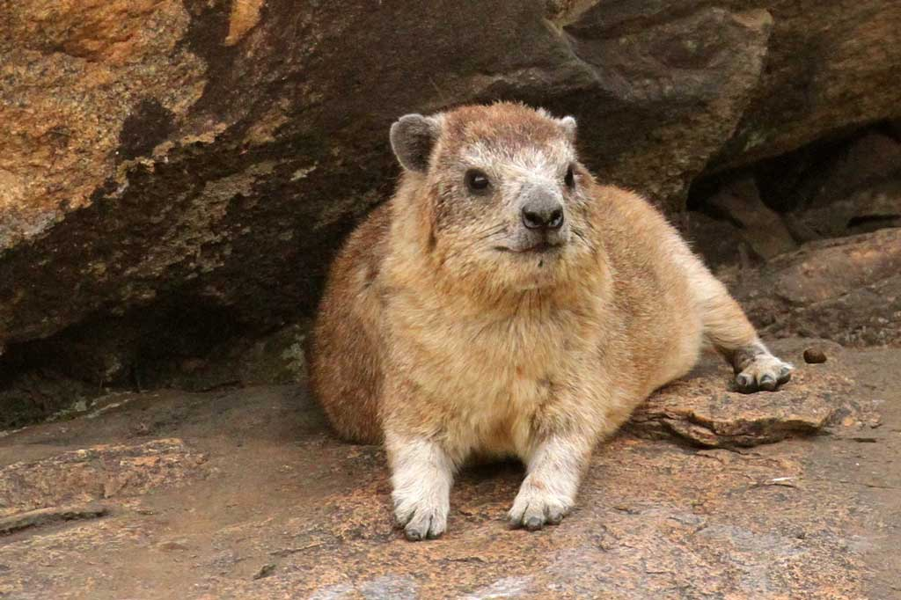

Slide 9
They live in rocky areas, and they do look like badgers. Both these animals and the rabbits were considered unclean because it says that, like the camels, they chewed the cud but didn't have split hooves.

Slide 10
This has been a source of criticism from some, because while the camels actually do chew the cud neither the hyrax nor the rabbits actually do. The camel does have some characteristics in common with ruminants, but the hyrax and rabbit don't have any. Therefore, critics accuse the Bible of scientific inaccuracy. The problem with this criticism is that this passage isn't trying to be a scientific description of ruminants. God's purpose here isn't to teach the people about the animal kingdom. His purpose is to give clear guidelines about what animals were clean and which were unclean. The hyrax and the rabbit, while they aren't literally chewing the cud, they are always moving their jaws in such a way as to give the appearance they are constantly chewing. The people who saw these animals could easily assume they were chewing the cud, even if they weren’t, and mistake them for clean animals.

Slide 11
Pigs do have split hooves, but they don't chew cud. They were unclean.
Looking ahead to the passage from Deuteronomy, other animals they were allowed to eat included various types of deer, as well as goats, cattle, and sheep.

Slide 12
Verses 9-12
The next group of animals mentioned here is water life. Here God doesn't mention any specific animals, He simply makes a broad command. They weren't to eat any animals from the water that didn't have fins and scales. They have to have both fins and scales: they couldn't have just one or the other; they had to have both. Most species of fish are included in this, but it excluded shell-fish, sharks, eels, oysters, etc.

Slide 13
Verses 13-19
Unlike the other animals mentioned there wasn't a physical characteristic they could use to distinguish between the clean and unclean birds. The unclean birds were simply listed. Any bird that wasn't included in this list was considered clean. Most of these birds were carrion birds: scavengers that ate from dead carcasses. It would make sense that these birds would be considered unclean since coming into contact with a dead body would make a person unclean, logically eating an animal that ate dead bodies would also make you unclean. The list is identical in Deuteronomy.

Slide 14
The one animal listed here that may raise some eyebrows is the bat, since as we know today the bat isn't really a bird, it is a mammal. Once again we have critics accusing the Bible of scientific inaccuracy here. But, once again, we have to point out that God isn't trying to teach the people about the animal kingdom. He let us do that on our own. The purpose here is to give them clear distinctions about what they could eat and what they couldn't eat.

Slide 15
The bat is a mammal, but it can fly like a bird. Many in those times considered it a bird, and God therefore grouped it together with all of the other flying animals. The only other way to do would have been to but the bat into a separate category, which would have been needlessly complex. People during those time didn't have the same categories of animals that we have today. They grouped the animals differently, and God was dividing the animals according to clean and unclean using the animal groups as they understood them at the time. This doesn't indicate scientific inaccuracy. God was using what the people knew.

Slide 16
Verses 20-23
They were allowed to eat certain insects. The only types of insects they were allowed to eat were winged insects that “have above their feet jointed legs with which to jump on the earth.” This would have excluded bees and wasps, cockroaches, etc. The only insects they were allowed to eat were various kinds of locusts, grasshoppers, and crickets.

Slide 17
Verses 24-28
This passage is about coming into contact with the carcass of an unclean animal. Coming into contact with the dead body of an unclean would mean the person would also be ceremonially unclean until evening.

Slide 18
Some have misinterpreted verse 26 as meaning that coming into contact with these animals at any time would make a person ceremonially unclean, but that wouldn't make any sense because they were allowed to use unclean animals for the purpose of labor. They used donkeys as work animals and they were considered unclean. They would also ride on unclean animals. They were only supposed to avoid contact with the dead bodies of unclean animals. Of course, there would have been times when this would have been unavoidable because if their work donkey died, they would have to move it away from the camp. But this only made them ceremonially unclean until evening. As long as they followed the laws for making them ceremonially clean again then there would be no lasting problem.

Slide 19
This also does not include the clean animals because they would have to be able to have contact with the dead bodies of the clean animals if they were to be able to eat them and use them for sacrifices.

Slide 20
Verses 29-31
These animals were all considered unclean. This includes all species of reptile, and all species of small mammal. Once again, though, the prohibition was only concerning the dead bodies of these animals. Touching a living mouse wouldn't make them unclean, though they would want to make sure to get it out of their home.

Slide 21
Verses 32-35
Anything that their dead bodies touched was also to be considered unclean. This would also have been true of the other unclean animals, but since those animals weren't likely to be in their home the chances of them touching their dishes was remote. Mice and lizards however were small and could get into their homes. If they did, and died there, anything their dead bodies touched was to be considered unclean. Wooden utensils were to be cleaned and considered unclean until evening. Clay pots were to be broken. Any food that is touched would also become unclean and therefore inedible, and any drink should be poured out. If they died in the ovens or stoves then those too would be considered unclean and were to be smashed and replaced. They couldn't use them for cooking food anymore.

Slide 22
Verse 36
Water was scarce enough that a cistern of water was still considered clean even if a dead mouse fell into it, though the one who removed the dead mouse was still considered unclean.

Slide 23
Verses 37-38
If an unclean animal died on dry seeds then the seeds could still be used. However, if the seeds had been watered, meaning they had been planted and were starting to grow, then they couldn't be used anymore.

Slide 24
Verses 39-40
The one occasion when a clean animal was to be considered unclean is when the animal died either by natural causes or was killed by another animal. In these cases, the animal wasn't properly slaughtered, and was fit neither for eating or sacrifices. It was to be considered unclean.

Slide 25
Verses 41-43
These would have included snakes, centipedes, or anything else that wasn't clearly mentioned in any of the other sections. Snakes are reptiles, but they are distinct from lizards in that they don't have legs. Centipedes are similar to insects, but they don't have wings. All of these creatures were also to be considered unclean.

Slide 26
Verses 44-47
Here we are given the reason for this: God wanted them to consecrate themselves and be holy. This was all about obeying God, and separating themselves from the other nations. God didn't bring them out of Egypt so they could be just like all of the other Godless nations. He wanted them to be different.

